Slide 1
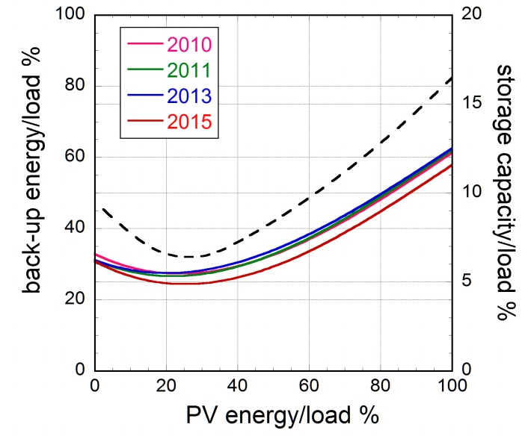
1
Surplus from and storage of electricity generated by intermittent sources
F. Wagner
Max-Planck-Institut für Plasmaphysik, Greifswald, Germany
Goal:
Assess variability from year to year: 2010, 2012, 2013, 2015
Principles: use data of a year and scale them to so called 100%, optimal mix case
The optimal mix

Slide 2
2
Year-to-year comparison
Generation by iRES: 500 TWh
 | 2010 | 2012 | 2013 | 2015
production Won TWh | 262 | 271 | 270 | 258
production Woff TWh | 131 | 135 | 136 | 129
production PV TWh | 107 | 94 | 94 | 113
production back-up/surplus TWh | 136 | 131 | 137 | 122
installed power Won GW | 188 | 176 | 183 | 117
installed power Woff GW | 39 | 33 | 33 | 53
installed power PV GW | 142 | 97 | 109 | 128
installed power back-up GW | 75 | 73 | 72 | 73
full-load-hour flh h | 986 | 1209 | 1114 | 1270
capacity factor cf % | 11 | 14 | 13 | 14
utilisation factor uf % | (70) | 59 | 60 | 57
For given installed power electricity generation can vary by 30 %

Slide 3
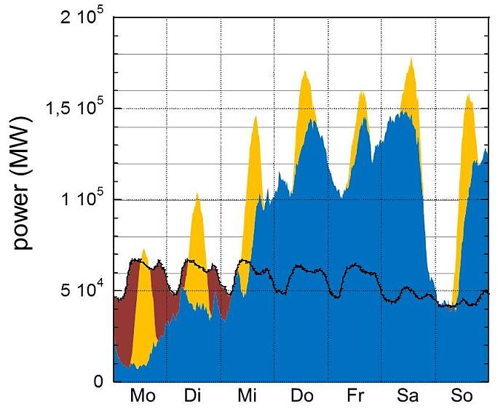
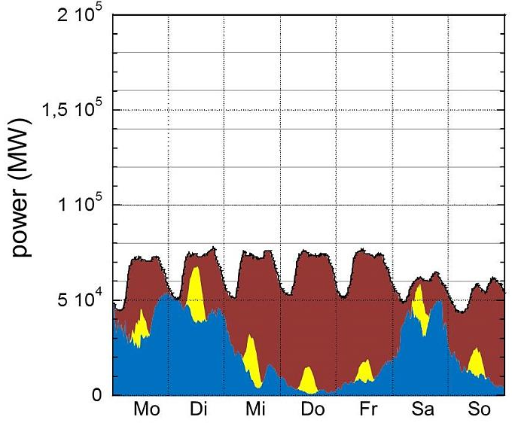
3
The extreme cases
Week with largest surplus
26.3. to 1.4.2012
Week with largest back-up
12.-18.11.2012
500 TWh generated
369 TWh (74%) directly used
153 TWh (41%) at a power level below or equal to the load
216 TWh (59%) with p above the load → the need for surplus production

Slide 4
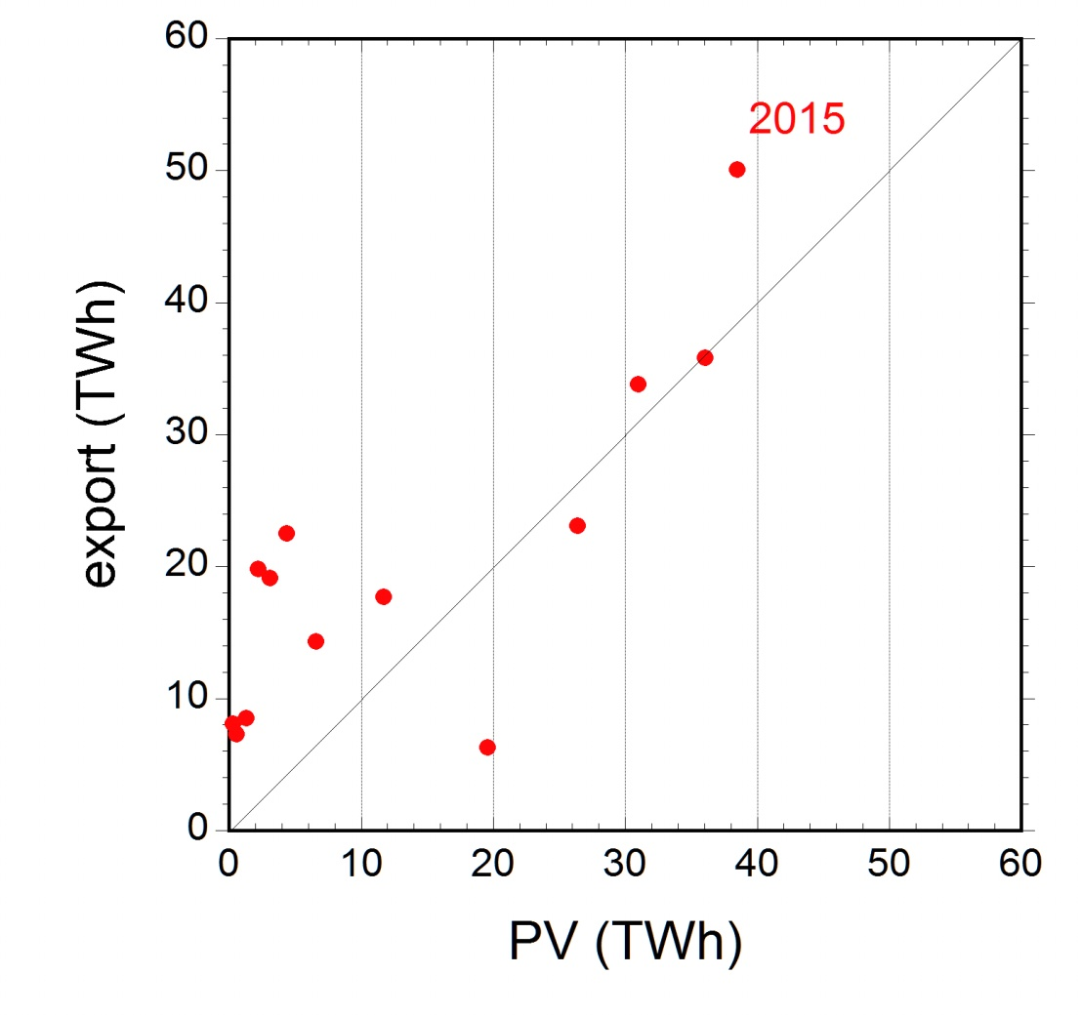
Surplus production today in form of export
The electricity export
strongly increases.
Numerically, the export
agrees with the PV
energy generated

Slide 5
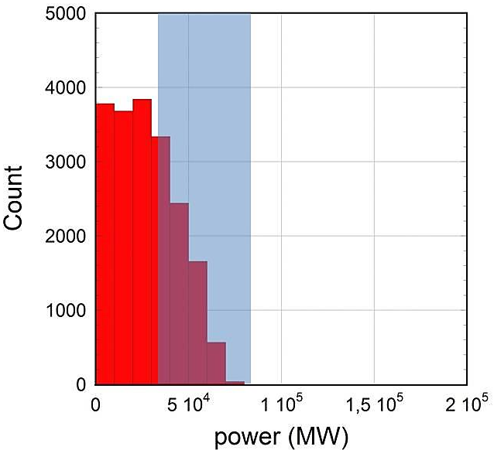
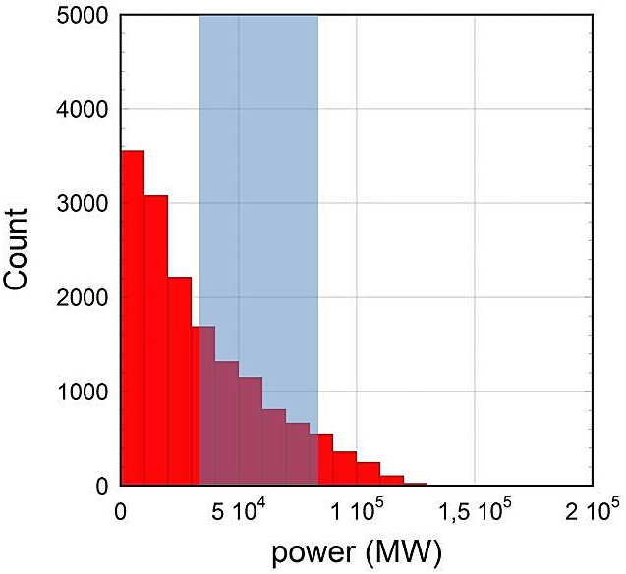
5
Power distribution
Back-up power
Surplus power

Slide 6
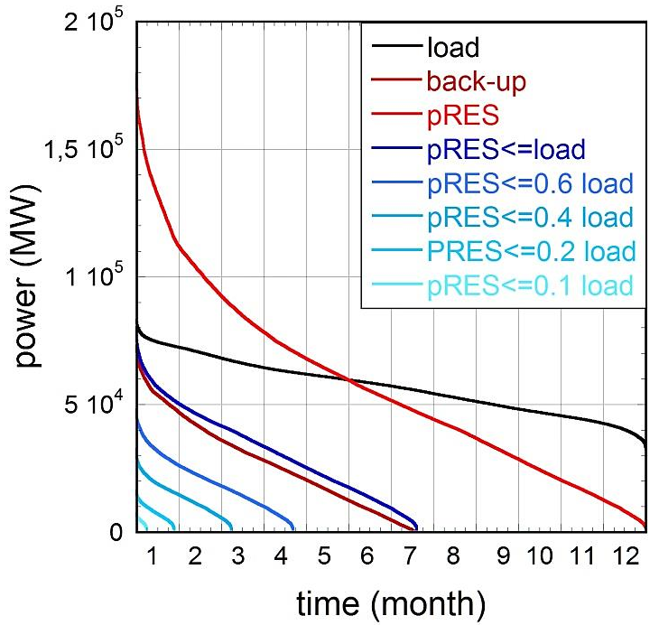
6
Partitioning of annual duration curve
2012
For 171 h power < 10% of the respective load
16 h with duration lower than 1 h
98 h with duration between 1 and 6 h
57 h with duration between 6 and 12 h.
2010
2013
2015

Slide 7
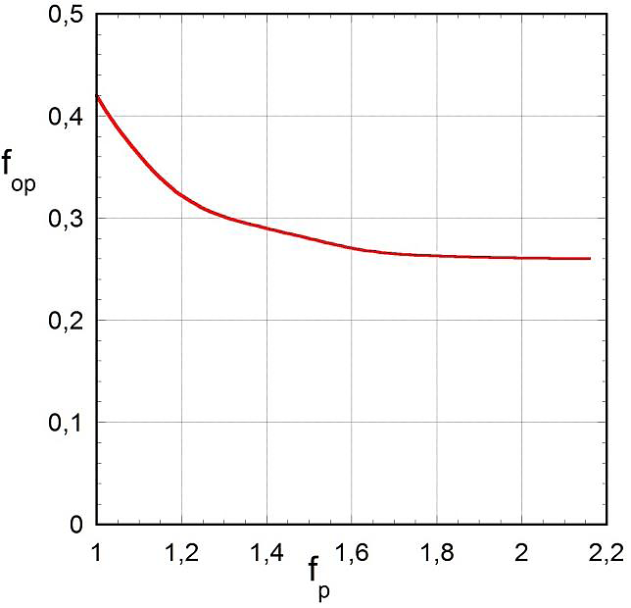
7
Consequences of curtailing power peaks
190 TWh
180 GW
131 TWh
f_{op} = ratio of overproduction to target energy (500 TWh)
f_{p} = peak grid power to peak power of the load (83 GW in 2012).

Slide 8
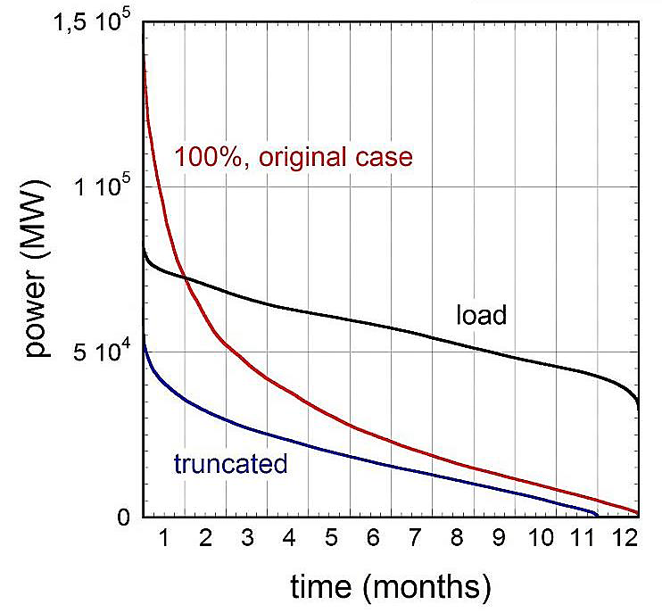
8
Curtailing onshore wind whenever p_{iRES} above load
Onshore wind contribution drops from 271 to 149 TWh → importance of Won.
The Won capacity factor drops from 0.18 to 0.08
Remaining surplus: 9.7 TWh.

Slide 9
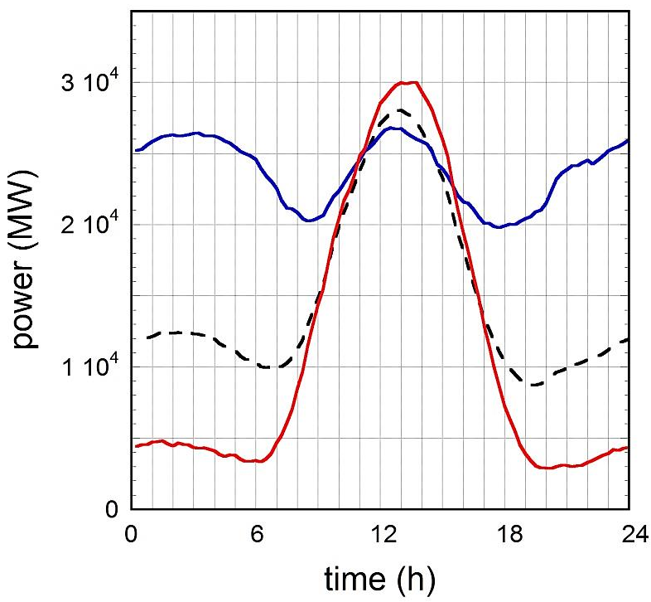
9
Conditions for demand-side-managment
Daily variation of
average surplus power
Strategy:
Shift surplus from day into night
total: 131 TWh
During the day: 83 TWh
Average per day: 0.23 TWh
Maximum: 1.2 TWh
Standard deviation: 0.29 TWh
Maximum during the day

Slide 10
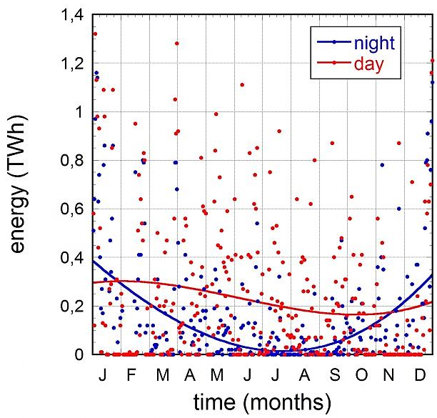
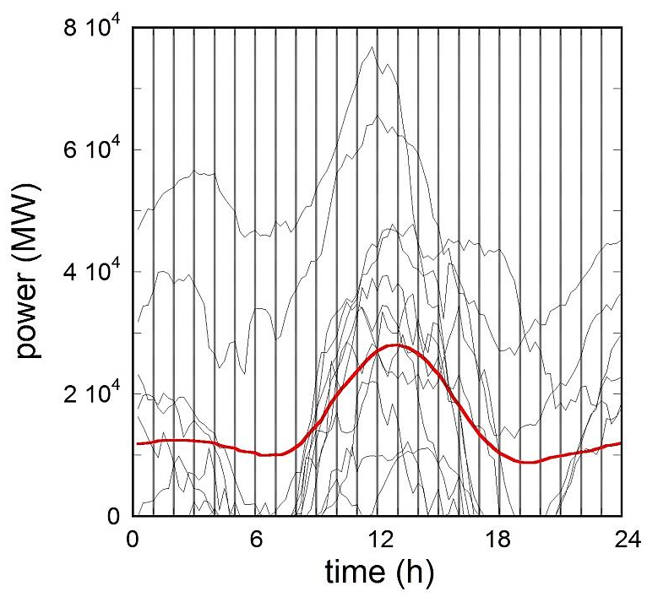
10
Conditions for demand-side-managment
Variation of surplus energy
during the day 6:00 – 18:00
and during the night
Variation of surplus power
for 3 weeks in April 2012
Red: average
No surplus for 134 days (2012)
The day-to-day variation seem to be too large to base repetitive
processes on the DSM concept

Slide 11
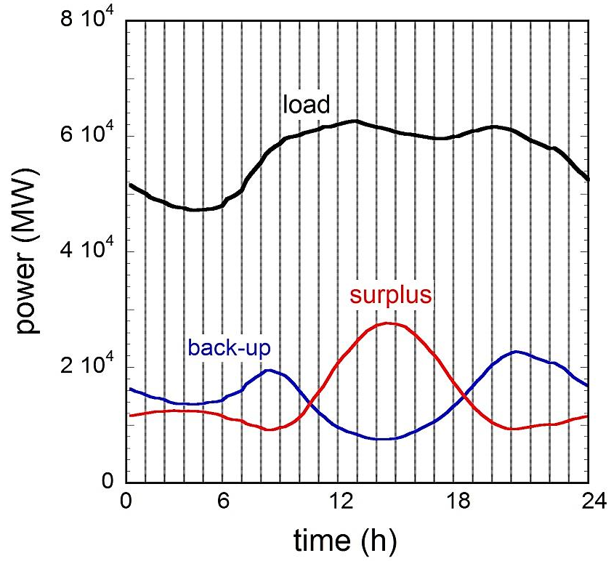
11
Viability of day storage
Surplus – back-up from
9:30 to 18:00 : 0.1 TWh.
daily demand :1.36 TWh
average daily surplus : 0.36 TWh
1/3 of it can be moved from the
day to the night

Slide 12
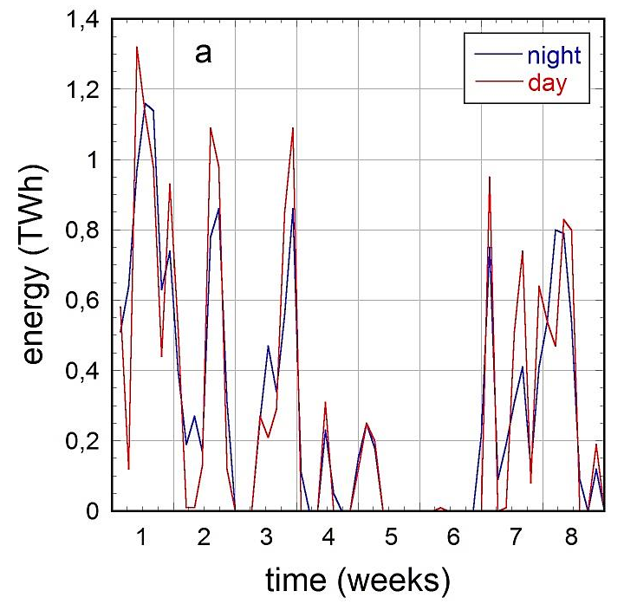
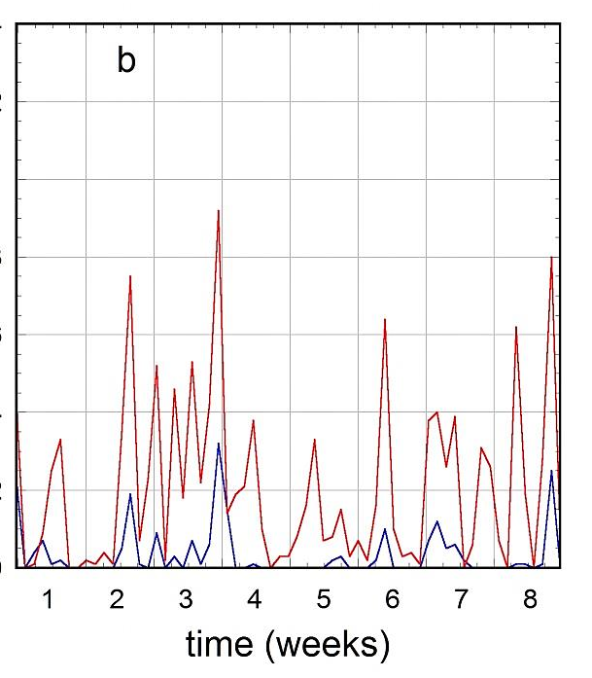
12
Viability of day storage
Daily surplus energies for two months in winter (January and February 2012)
for two in summer (July and August) split into the day and the night periods.
In winter: strong correlation between day and night → no transfer

Slide 13
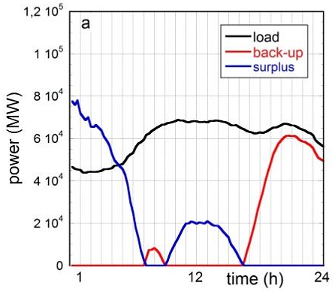
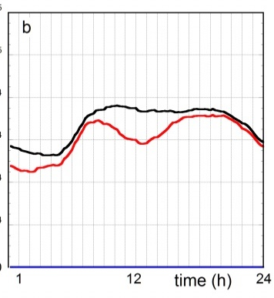
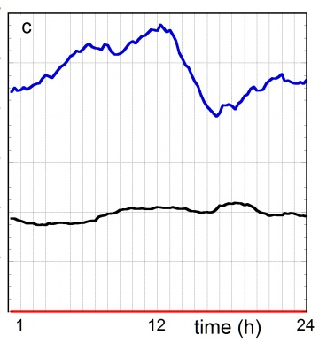
13
Viability of day storage
reduced load, back-up and surplus power shown for three cases
the day (2.4.12) with the largest energy transfer from the storage to the grid
the one (15.11.12) with the largest back-up need
the one (31.12.12) with the largest surplus energy
Daily storage with 0.36 TWh = average daily surplus energy in 2012
Work done in 195 days: 21.7 TWh
Surplus power on April 2nd with the largest transfer: 80 GW
capacity factor: 3%

Slide 14
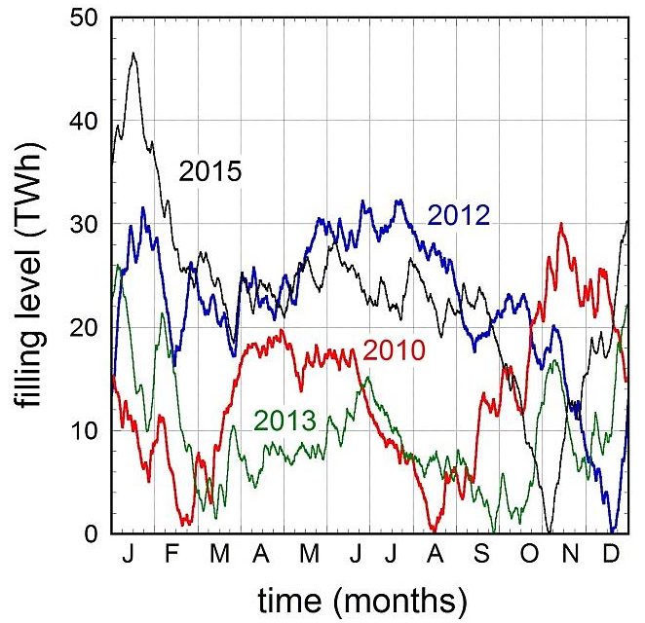
14
Seasonal storage (ideal case)
filling level strongly depends
on the weather conditions
The storage capacity varies
between 26 TWh (2013) and
46 TWh (2015)
Storage empty in fall

Slide 15
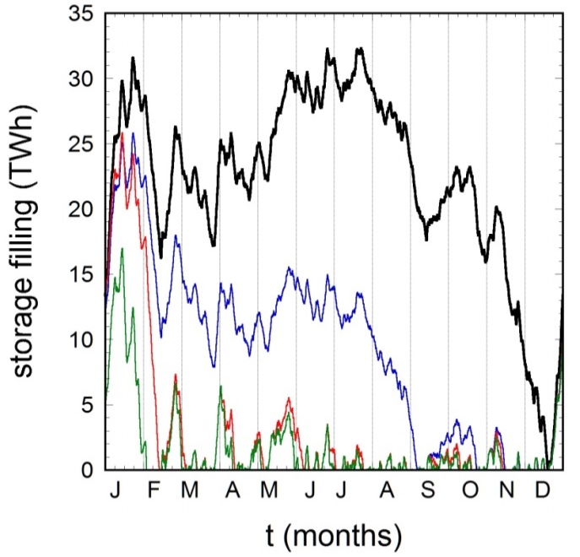
15
Seasonal storage (with losses)
2012, no losses
electricity → H₂
(η = 0.8)
electricity → H₂ → electricity
(0.6)
electr. → H₂ → CH₄ → electr.
(0.4)
Seasonal storage loses character:
short operational periods
after bursts of surplus

Slide 16
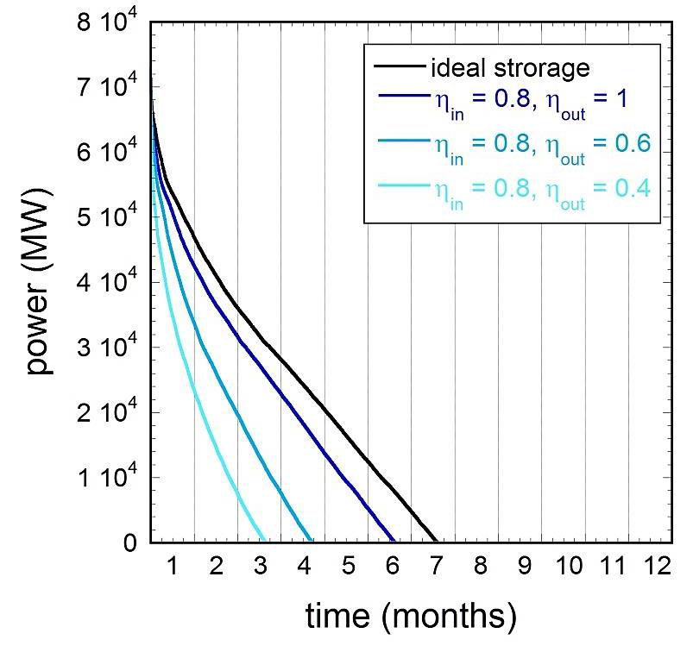
16
Seasonal storage (with losses)
I doubt that there will be
storage to close the
electricity loop with
intermittent RES

Slide 17
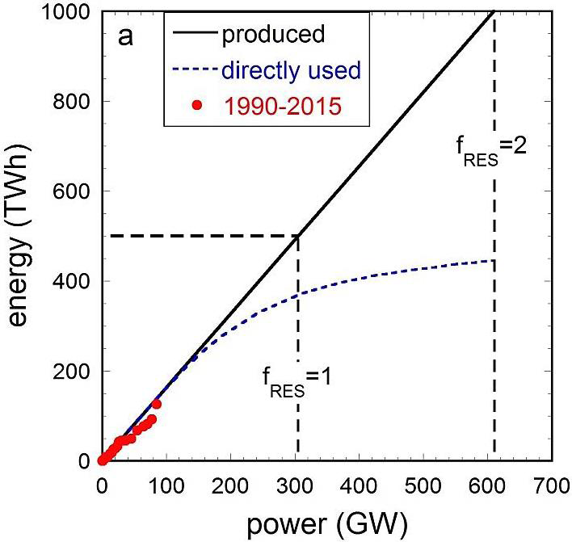
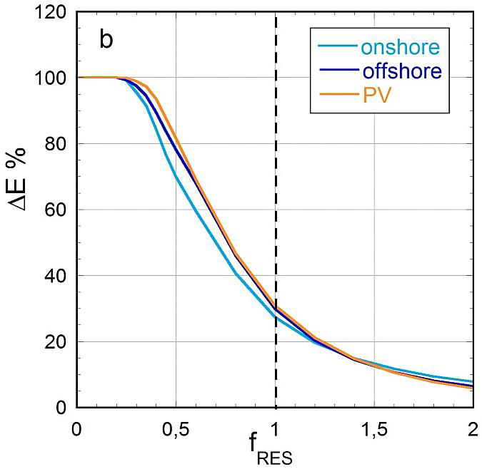
17
Concept: allow overproduction > 500 TWh
General features of overproduction:
Saturation of directly used energy
Direct energy gain ΔE by
adding 10 GW to the stock

Slide 18
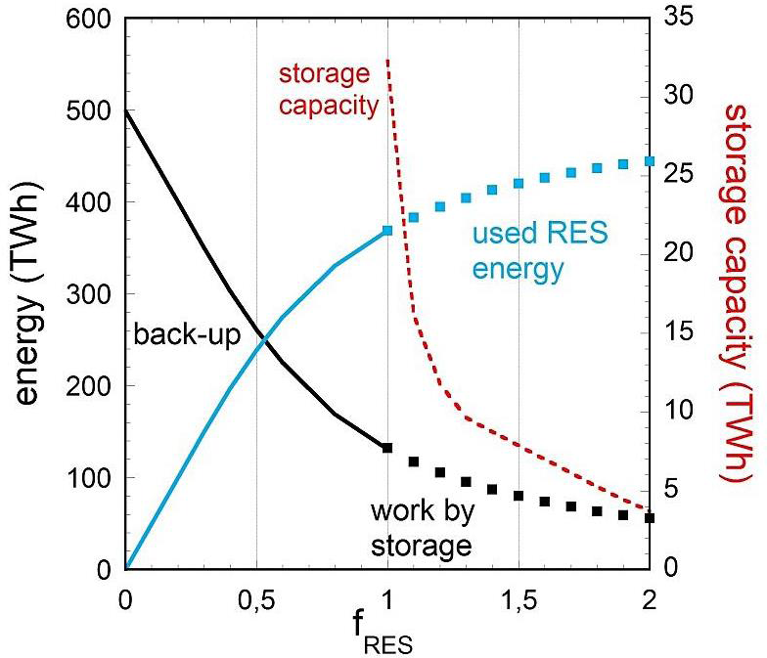
18
Concept: allow overproduction > 500 TWh
Strong decrease of storage
capacity, because
used energy approaches
500 TWh target
f_{RES} = 2: 55 TWh missing,
irrelevant
But: at the expense of large
overproduction

Slide 19
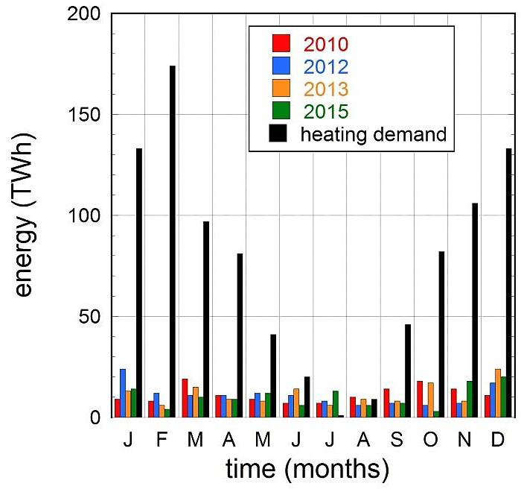
19
Best use of surplus: heating
f_{RES} = 1

Slide 20
20
CO₂, GHG development, past and expected
expected development
with present regulations
if lignite had been
removed instead
of nuclear power
if 2011 all coal power
stations had been
replaced by gas
2025
target
GHG emission (Mill t/y)

